Slide 1
Designing a Sentence Repetition Task in LSF A new approach to assess LSF abilities
Caroline Bogliotti¹, Aliyah Morgenstern², Frédéric Isel¹
¹ Laboratory MODYCO CNRS & Paris Nanterre University
² Institut du Monde Anglophone & Sorbonne Nouvelle University, Paris
Notes:
Today, I’m talking on designing of a new sentence repetition task T in LSF
We propose a new approach to assess LSF abilities.
This study was conducted in collaboration wirf Frederic Isel and AMO, and all partners of SignMEt Project.
.
This task has been created during the European SignMEt Project.

Slide 2
The Sentence Repetition Task (SRT)
Since the 70’s, SRTs are frequently used for testing Vocal Languages (among others Conti-Ramsden et al., 2001; Chiat et al., 2013)
Provide a good estimation of language processing and development
in various populations
Native speakers
Bilingual speakers
Second language learners
Children with language disorders such as SLI or adults with aphasia ;
Socioeconomic disabled populations.
Present several technical advantages
Easy and quick to run
Assess explicit linguistic structures previously specified
Not too time-consuming
Notes:
In litterature of psycholinguistic and clinical research, lot of studies have used SRT in order to assess abilites of Vocal Languages
And they reported that Sentence Repetition Tasks provide a good estimation of language processing and development and have been used in various populations : native speakers, …
This task present several technical advantages as to be easy and quick to run.
------------------

Slide 3
Sign language SRT
More recently, SL Repetition Tasks have been adapted to measure the language ability of deaf people
ASL
adults; native, late signers and hearing L2 signers (Hauser et al., 2008 ; Suppalla et al., 2014 ; Morford, 2003)
BSL
adults; natives, early and late signers (Cormier et al., 2012 )
deaf SLI children and deaf controls (Marshall et al., 2015)
LSF, LIS, LSC, and DGS
Native signers and late signers, children and adults (SignMet Project; for LSF: Bogliotti et al., in prep ; for LIS : Rinaldi et al., 2018)
Notes:
More recently, SL repetition task have been adapted to measiure the language ability of deaf people.
They have been used in ASL and BSL, and 4 others languages. The last 4 tasks have been elaborated during the European project SignMET
BUT, we lack SRT in LSF, and in others SL
This was precisely the goal of the european Sign MET project : create a battery of assessment in these 4 SL, in which we find a SRT

Slide 4
State of the art of LSF
assessment tools
None of the existing tools are not used
TESLSF, Niederberger et al., 2001 (too long and difficult to score)
LSF receptive skills tests, Courtin et al. 2010 (adaptation to improve)
EVASIGNE: battery of LSF assessment (Bogliotti & Blondel. See Puissant-Schontz poster, 2018)
Here, our goal is to fill this gap by providing a better screening tool in LSF, for clinical, educative and scientific communities.
Our assessment will take into account the specificities of deaf populations in terms of:
Age of acquisition
Length of exposition
Type of input
Notes:
Before to pressent SRT, let me remind you the state of art of LSF tools in LSf
There have been several attempts to create several tests but none of them is really used because not sufficiently reliable
The TELSF is too long to run and really difficult to score;
There is no successful adaptation for the LSF receptive skills test.
Hovewer, these tests enabled us to hightlight which constraints and difficulties we meet when we adapted a language test.
CLIC
So our goal is to fill this gap by providing a first screening tool in LSF used in all people who working with deaf people.
CLIC
We want to create and assessment which takes into account the specificities of deaf populations in order to capture the influences of the following factors

Slide 5
The present study
Our task is inspired by the BSL-SRT and adapted to French Sign Language and French cultural constraints (European SignMET project, Italian PI CNR Cristina Caselli and Pasquale Rinaldi)
Deaf people and SL linguists have discussed the syntactic elements and semantic interest of the sentences.
20 sentences, varying in length and syntactic complexity.
10 minutes long
Notes:
So for the present study, we built a task inspired by an exisiting SRT
A group of deaf students and sign language linguists discussed the linguistic and cultural adaptation.
At the end of the process, the materiel was constitu have 20 sentences, varying in length and complexity.
The SRT was relatively short in time, approximately 10 minutes long.

Slide 6
Stimuli
Item 3
Item 16
Notes:
So here you’ll find some exemples of sentences to repeat
Stimui are classified in 4 levels of complexity.
The level of complexity has been decided regarding several factors such as the number of signs, the type of morphosyntactic unit, and the argumental structure.
The sign span goes from three to six signs .
Deaf people and Sign language linguists decided together about the complexity.
For exemple, the item 3 is an easy item and the sixteen is a complex one.

Slide 7
Participants and procedure
62 children (38 female)
34 native signers
28 late signers
Age: 6;01 to 12;09 years.
All children received a bilingual education and used LSF as their preferred language
None of the children had other cognitive and / or social impairments.
Instruction: to repeat the sentences exactly as the signer in the video.
The children’s repetition were video-recorded in order to score their repetition abilities.
Notes:
WE submitted the SRT to 62 children, thirty-four were native and 28 were late signers
Children were aged 6 to 12 years old.
The Age of first exposure to LSF for Late signers is around 3 and 5 yo for late signers
In the next slide,you will see different repetititons from native and late signes
CLIC
Children were tested by deaf native signers or hearing fluent signers.
The instructions were to repeat the sentences exactly as in the model.
The children’s repetition were video-recorded

Slide 8
Some repetitions
« I take the hat that I have on my head and I put in on the child head »
Notes:
Here, you can see repetition by native and late children

Slide 9
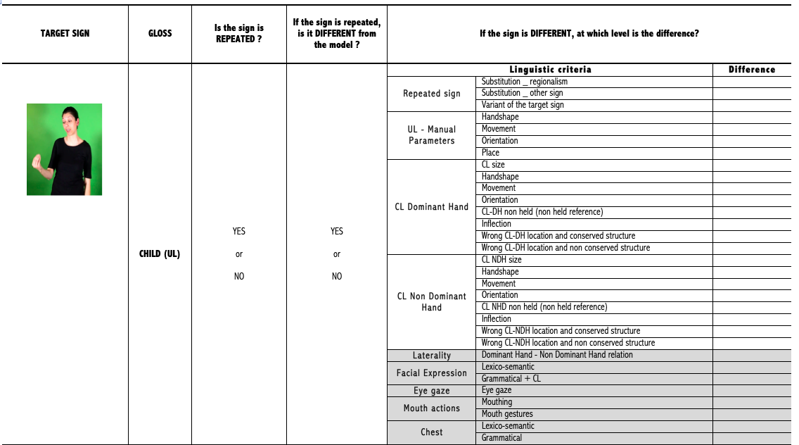
Scoring
Notes:
All children’s repetition were annotated twice, by two fluent coders.
For each sign in each sentence, we had to fill out this grid.
First, we had to report if the sign is repeated or not (YES or NO)
If the sign was repeated, we have to report if the repeated sign was different from the model or not.
If the sign repeated was different, we reported at which formal parameters the sign varied.
Once formal features were completed, we analysed all results regarding linguistic levels: are the difference phonological, morphosyntactic, and lexical-semantic differences.
For the present study, we decided to ignore non-manual variations because test situations and video recording can affect the repetition of non manual parameters

Slide 10
Results
 | Native | Late
6-7 | 12 | 10
8-9 | 11 | 10
10-12 | 11 | 8
We expected differences
General repetition abilities according to AOA and CA
Lexical errors (rate and types)
Phonological errors
Notes:
So we decided to cut off the population in several groups
First in AOA, and so we have a group of ntive signers and a group of late signers
For each group, we made age chronological groups
So before to anaulss results, we expected differences on : general repetition abiblites
And as previous studies on SL repetition measure lexical errors and types of errors)
As as phonologicl skills are predictive or link to later language abilities, we wanted to evaluate this part

Slide 11
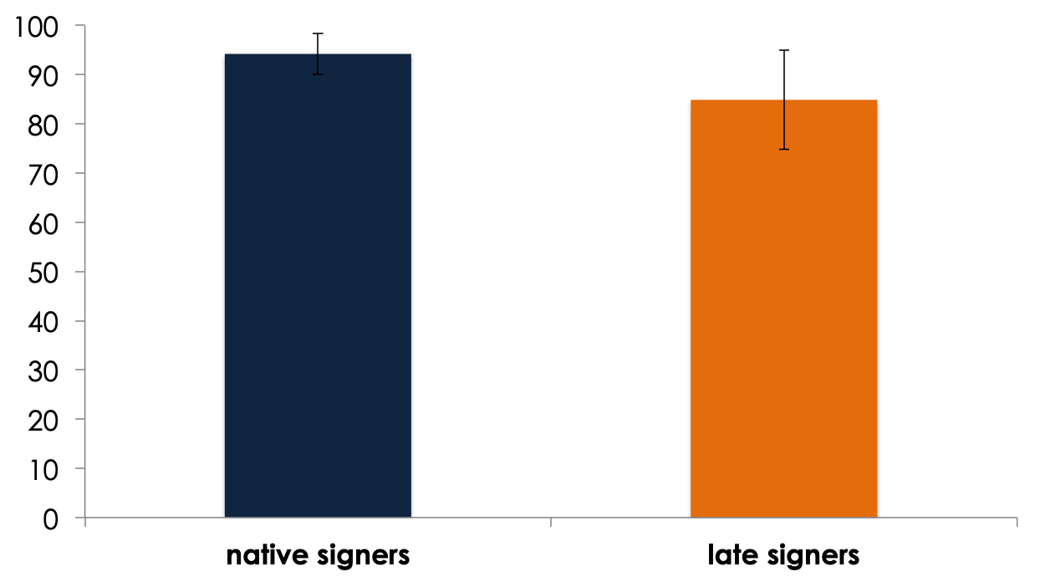
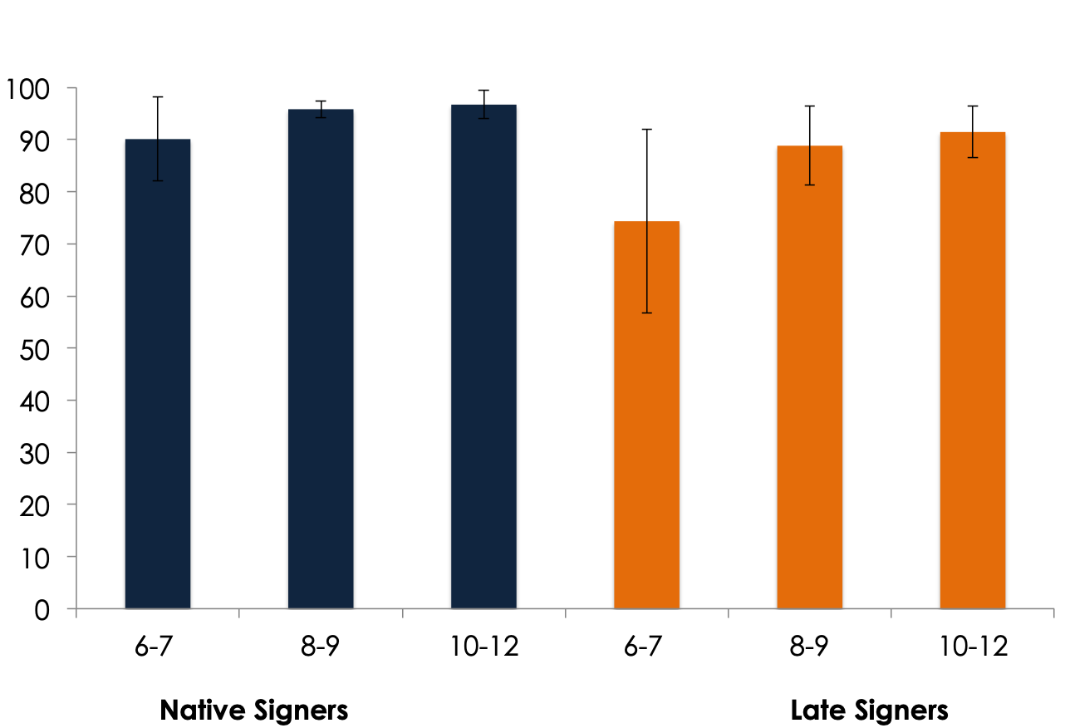
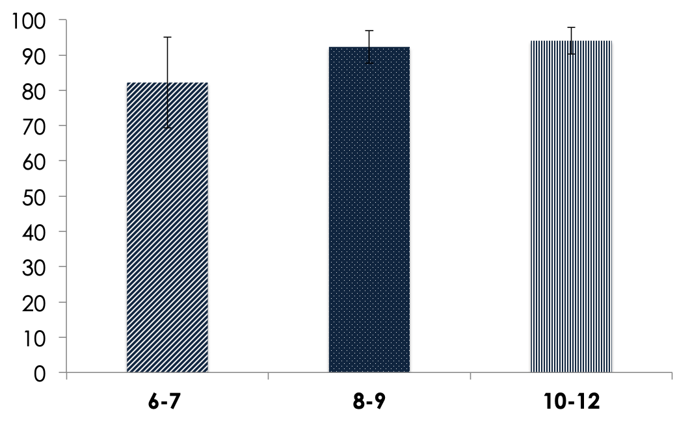
% of repeated signs
AOA
***
94
84
AC
***
***
n.s.
82
92
94
*** p<.001; ** p<.01; * p<.05
Notes:
Regarding to the general repetiion abilities, we observed that Native signers succeeded generally better in the SRT than Late signers = they repeated significantly more signs,
WHen we observe the effet of AGE, younger children outperfermed the orlder ones
SURPRISINGLY, older groups of signers perform equally better

Slide 12
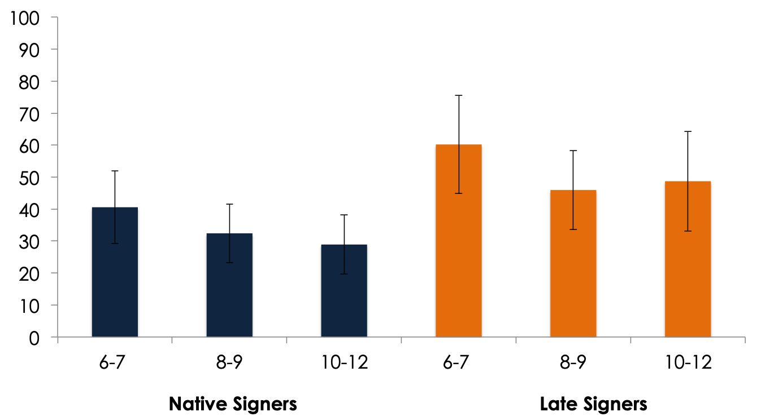
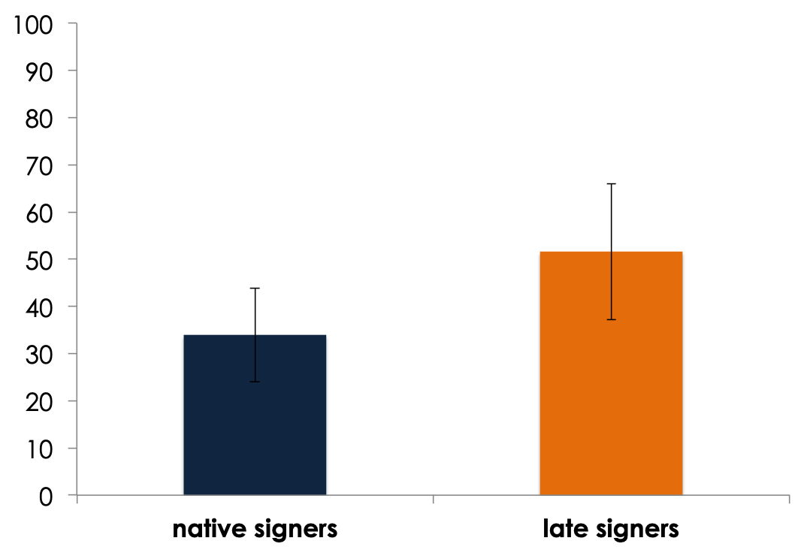
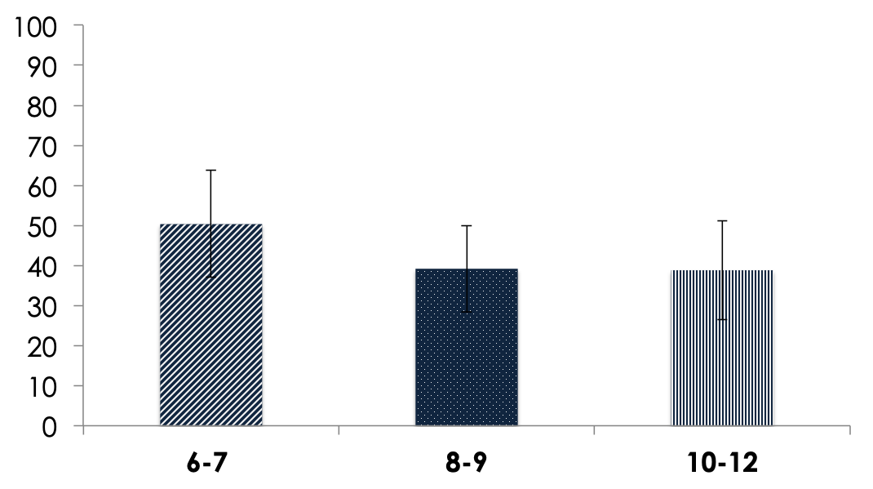
% of repeated signs with errors
AOA
***
33
51
AC
**
***
n.s.
50
39
38
*** p<.001; ** p<.01; * p<.05
Notes:
In a second time we analysed the percentage of repeated signs with errors,
Native signers made less errors when they repeated a sign in comparison to late signers
We observed the same patterns of results for the effect of age, younger signers present significant lower skills in comparison to older ones.

Slide 13
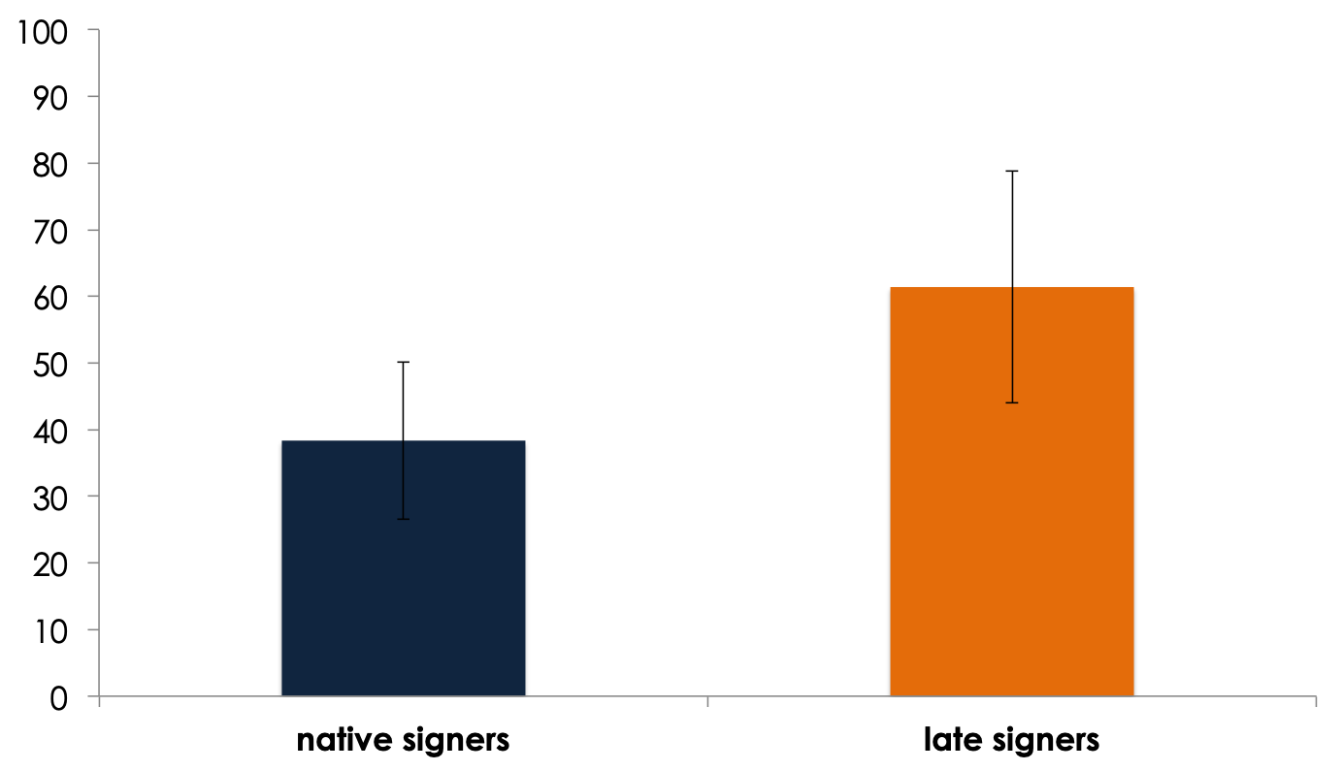
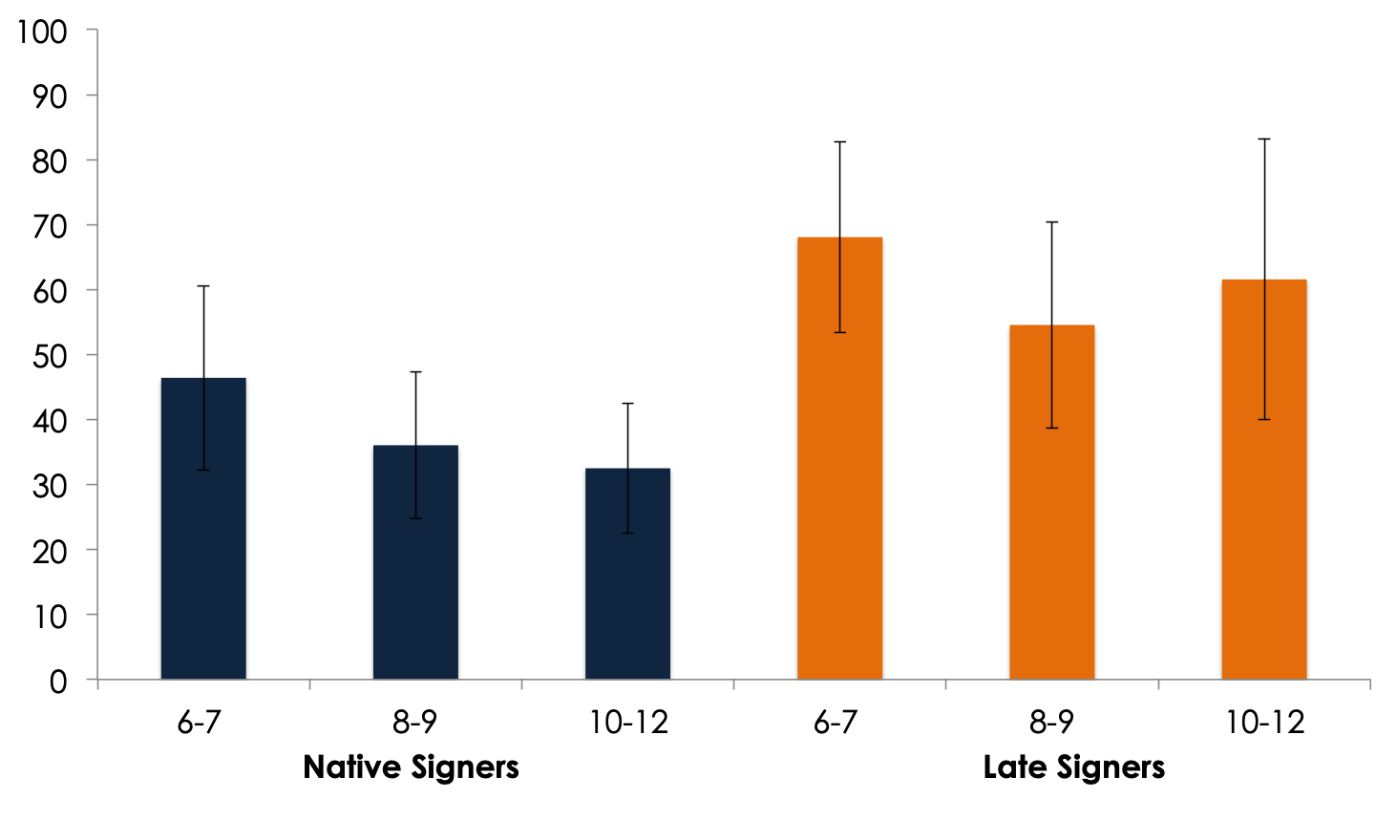
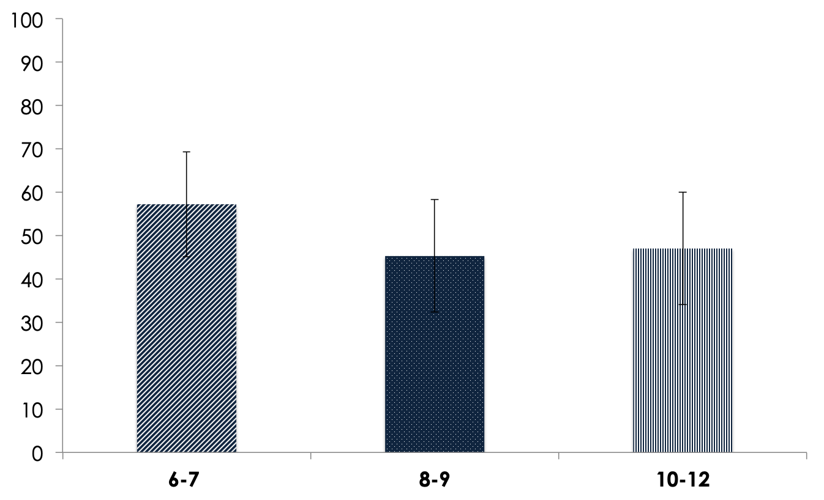
Lexical errors
AOA
***
38
61
AC
*
*
n.s.
57
45
47
*** p<.001; ** p<.01; * p<.05
Notes:
In addition , as I said previously, we’re interested to investigate the rate and the types of errors.
We can observe that late signers made significantly more lexical errors in their repetitions than native signers
Younger children made more errors than older ones.

Slide 14
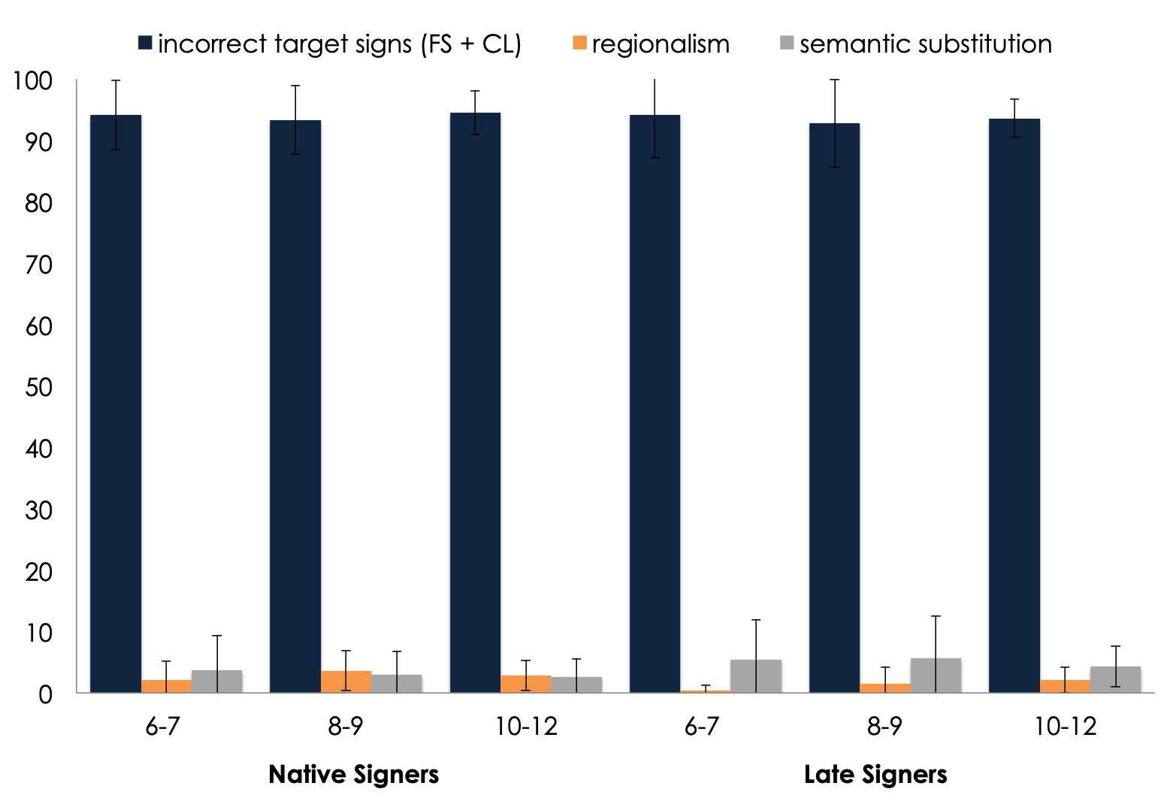
Types of lexical errors
substitutions / other signs
***
AOA ***
Notes:
More fine grained analysis allowzd us to see that in most case, the error was on the the target sign.
We observed rare cases of regionalism or substitutions. We have a signigication effect on AOA.
One frist explanation could be that, when we tested the native childre, we gone to the south of France and they procuded several regionalism
And we observed

Slide 15
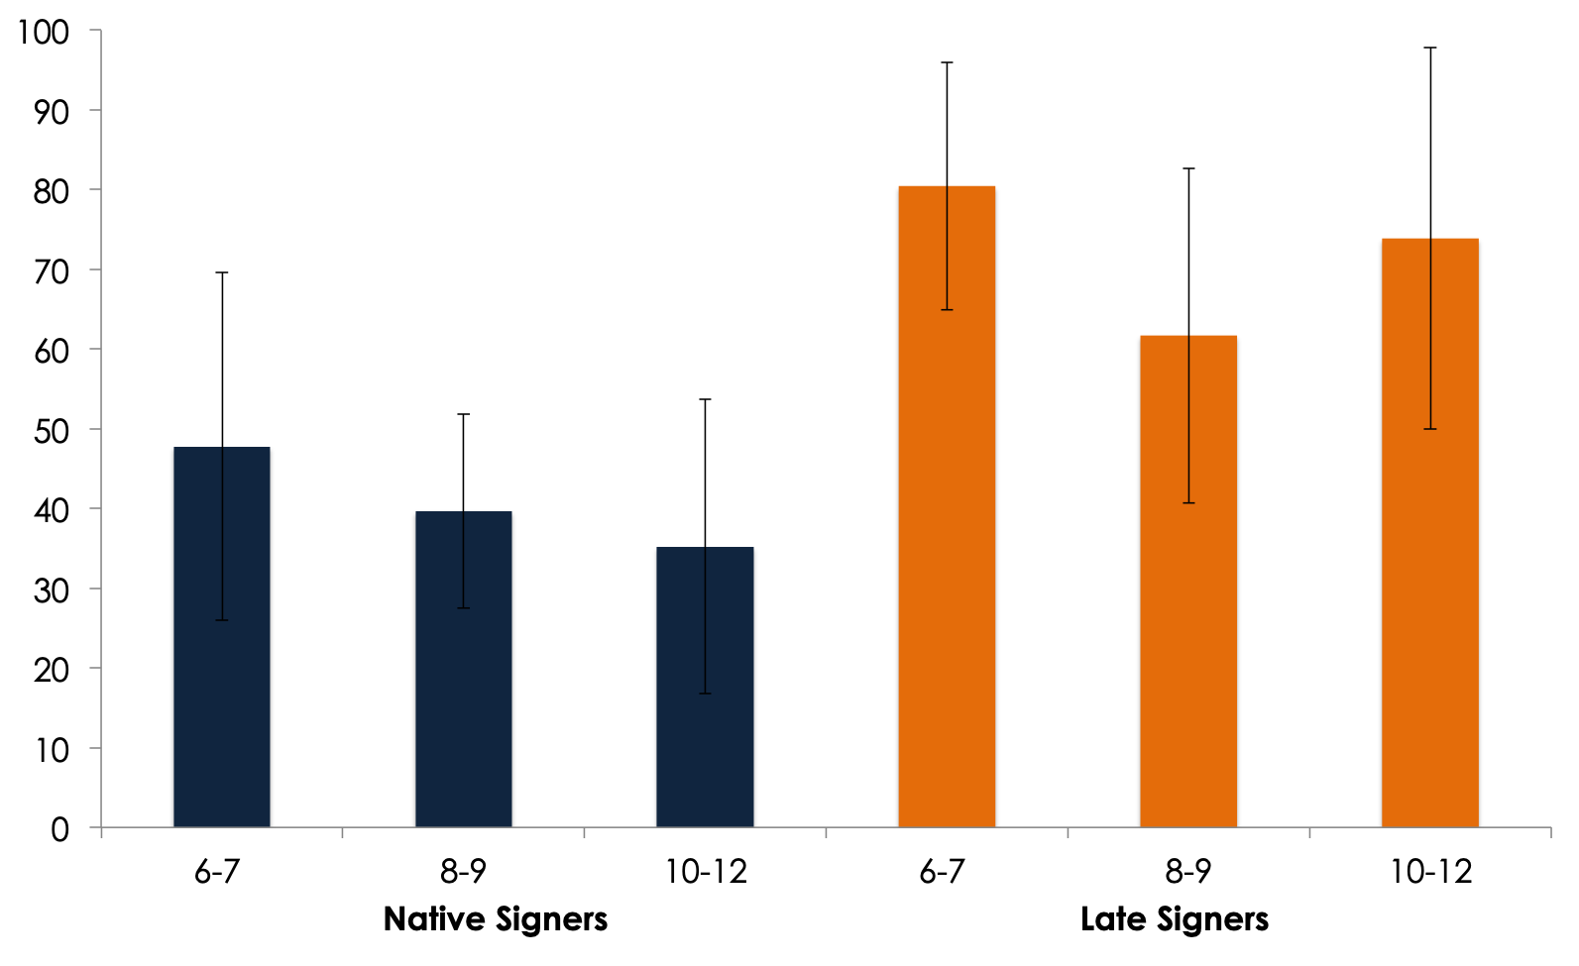
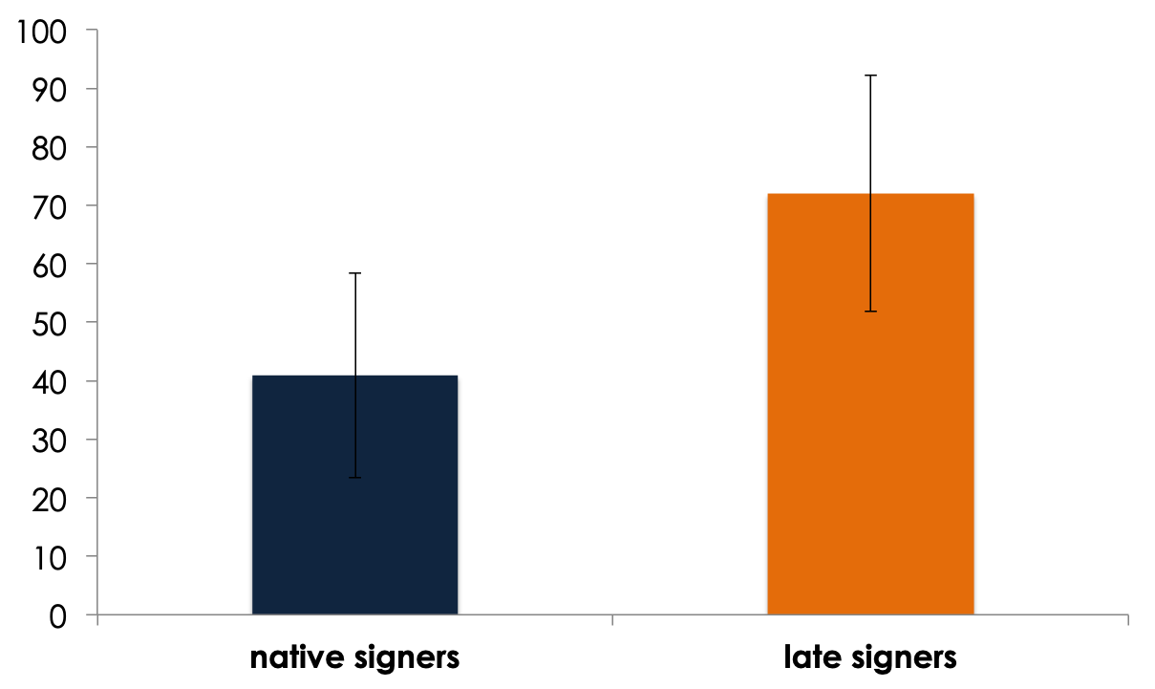
Phonological errors
AOA
***
40
72
*** p<.001; ** p<.01; * p<.05
Notes:
Finally, Regarding phonological errors, Native signers made significantly fewer phonological errors than late ones.
As frozen signs constitute the great majority of signs to repeat, phonological errors concern mostly frozen signs.

Slide 16
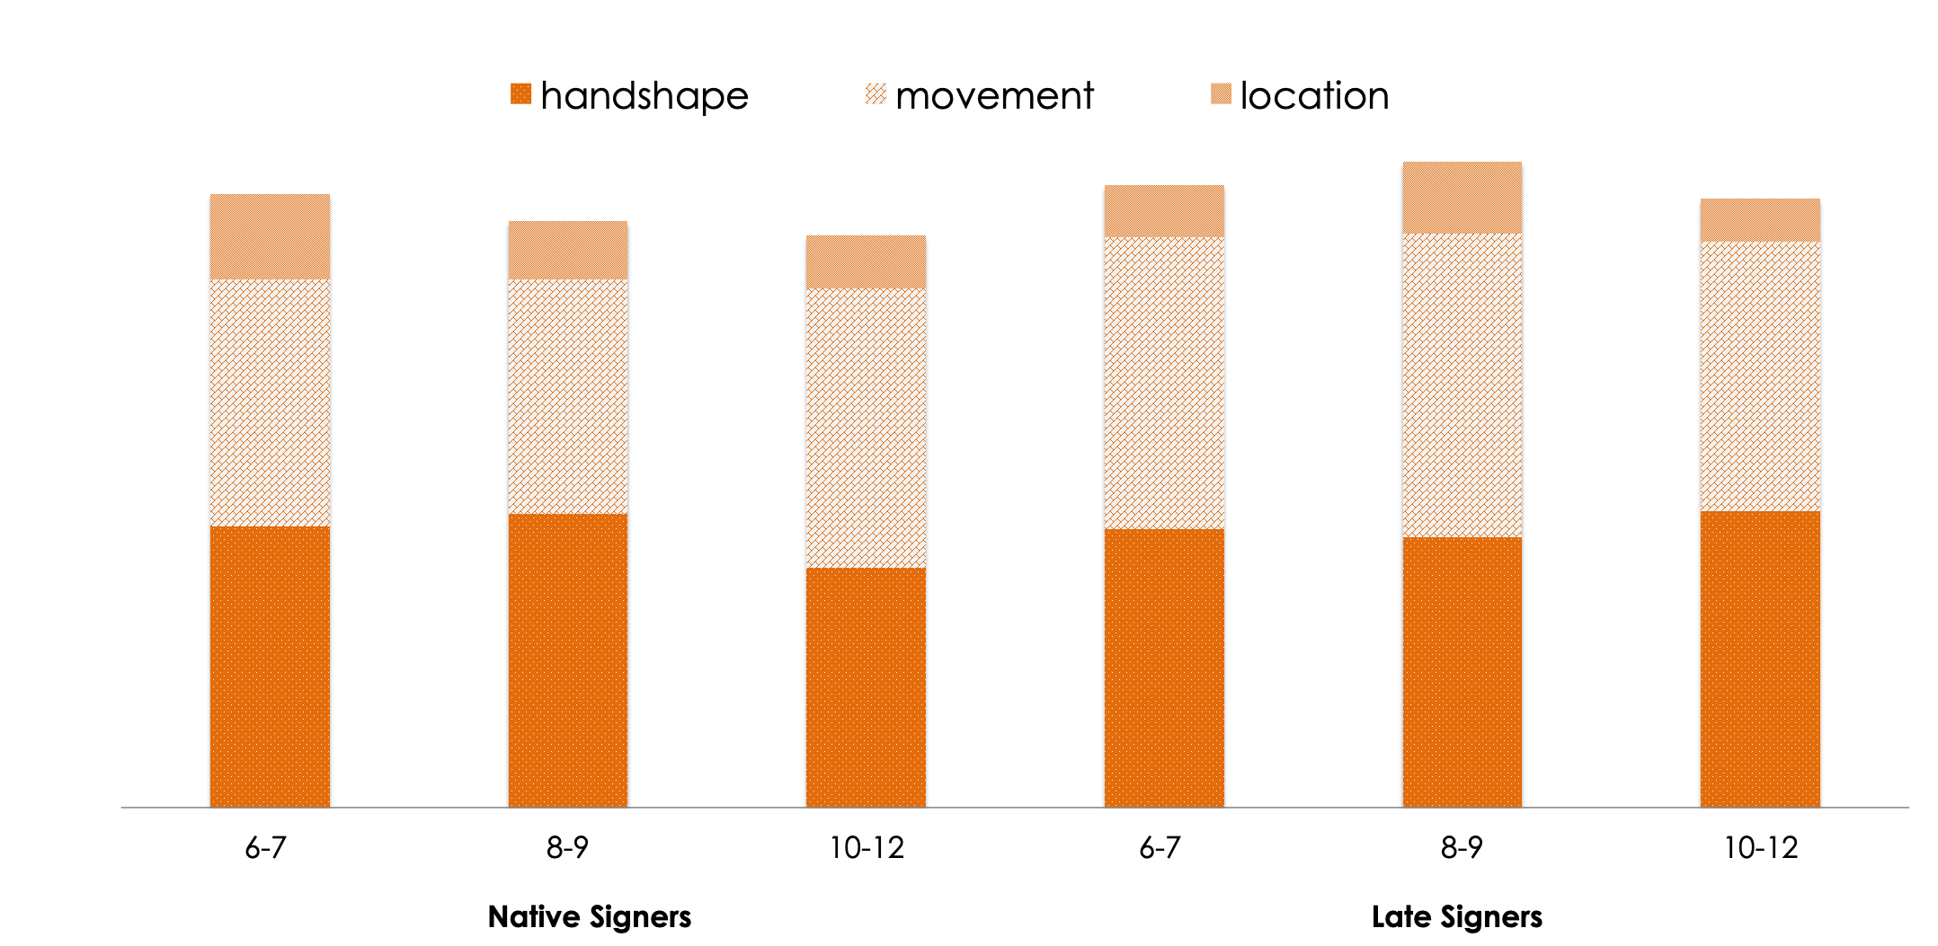
Types of phonological errors
type of parameter ***
*** p<.001; ** p<.01; * p<.05
Notes:
At last Consistently with previous literature, two phonological parameters are significantly more failed : movement and handshape. Location is well masterded whatever the AOA and the CA.
We observed a marginal effect of AOA.

Slide 17
Discussion
The adaptation for LSF is successful.
Highlights differences in repetition abilities between native and late LSF signers according to AOA, developmental tendency, length of exposition.
Replication of previous SL studies showing that movement and handshape are the most complex phonological parameters to acquire. Location is mastered early.
Usage-based explanation: experienced structures could be repeated better.
Notes:
We re happu becaise the adpatation of BSL SRT is successful
The SRT in LSF highlights differences in repetition abilities between native and late LSF signers ,
This means that SRT can capture the influenes of the factor as AOA, LoE , age.
We replicate previous results showing that movement and handshape are the most complex phonological parameters to acquire. Location is mastered early
We can advance and usage based explantion

Slide 18
Perspectives
We need qualitative analyses
Phonetic analysis : Measurement of failed sign phonetic complexity
Sign stream (ratio of number of signs / minute) : Late signers seem slower in their production.
Semantic analysis : in late signers, are substitutions mostly gestural or lexical ?
Further investigation could be run on Specific Language Impairment for deaf children in order to assess the screening power of SRT.
To demonstrate whether SR abilities are predictive of other language skills.
Notes:
In the future, we need to do some qualitative analysis, as measure the phoetic complexity of signs failed
Or measure the sign stream because late signers seems slowed their production
Iother Further investigation could be run on SLI children in order to assess the screening power of SRT.
We have to determnie if SR abilities predictive of other language skills ? Maybe the next communication will answer this question .

Slide 19
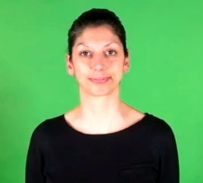
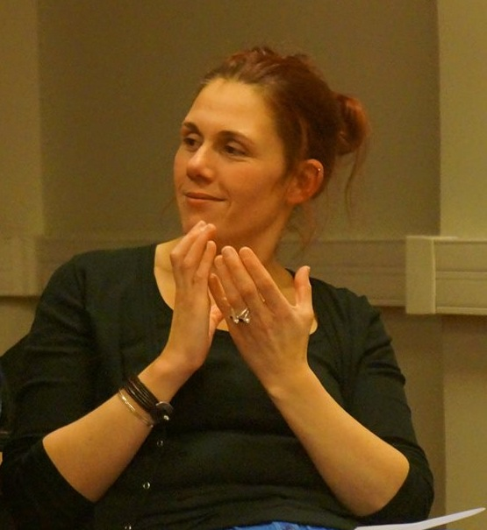
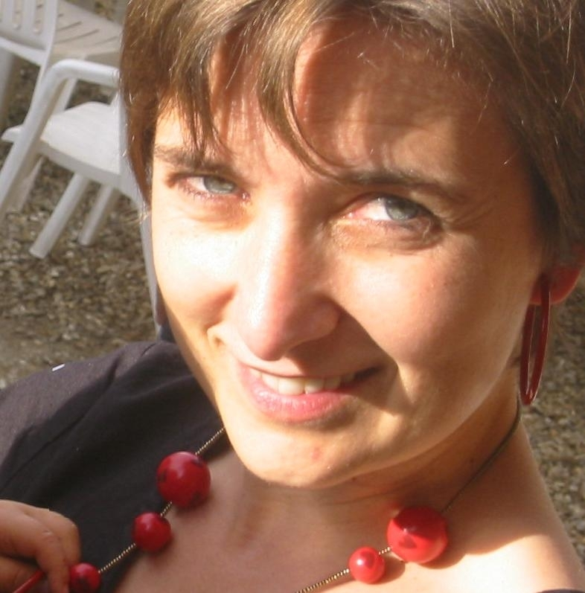
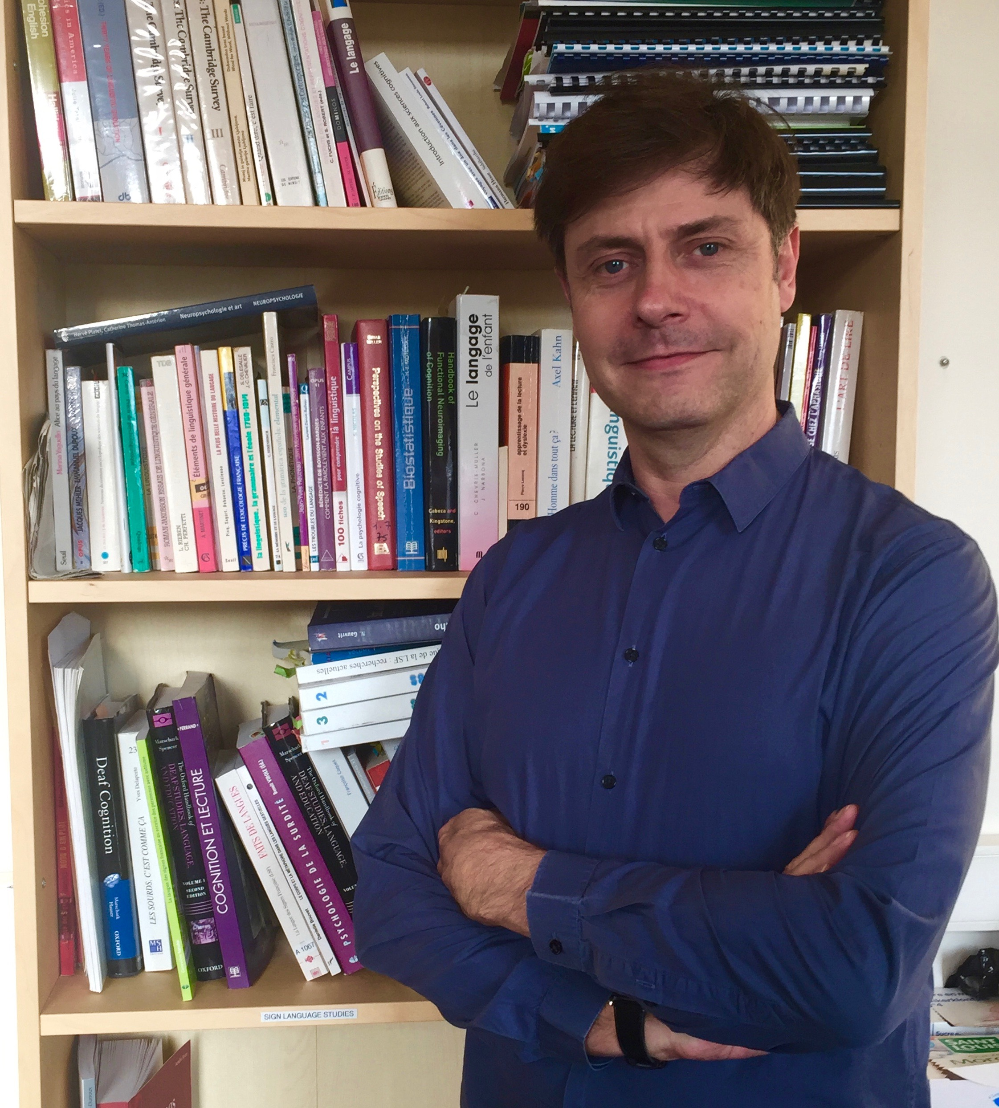
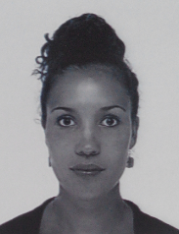
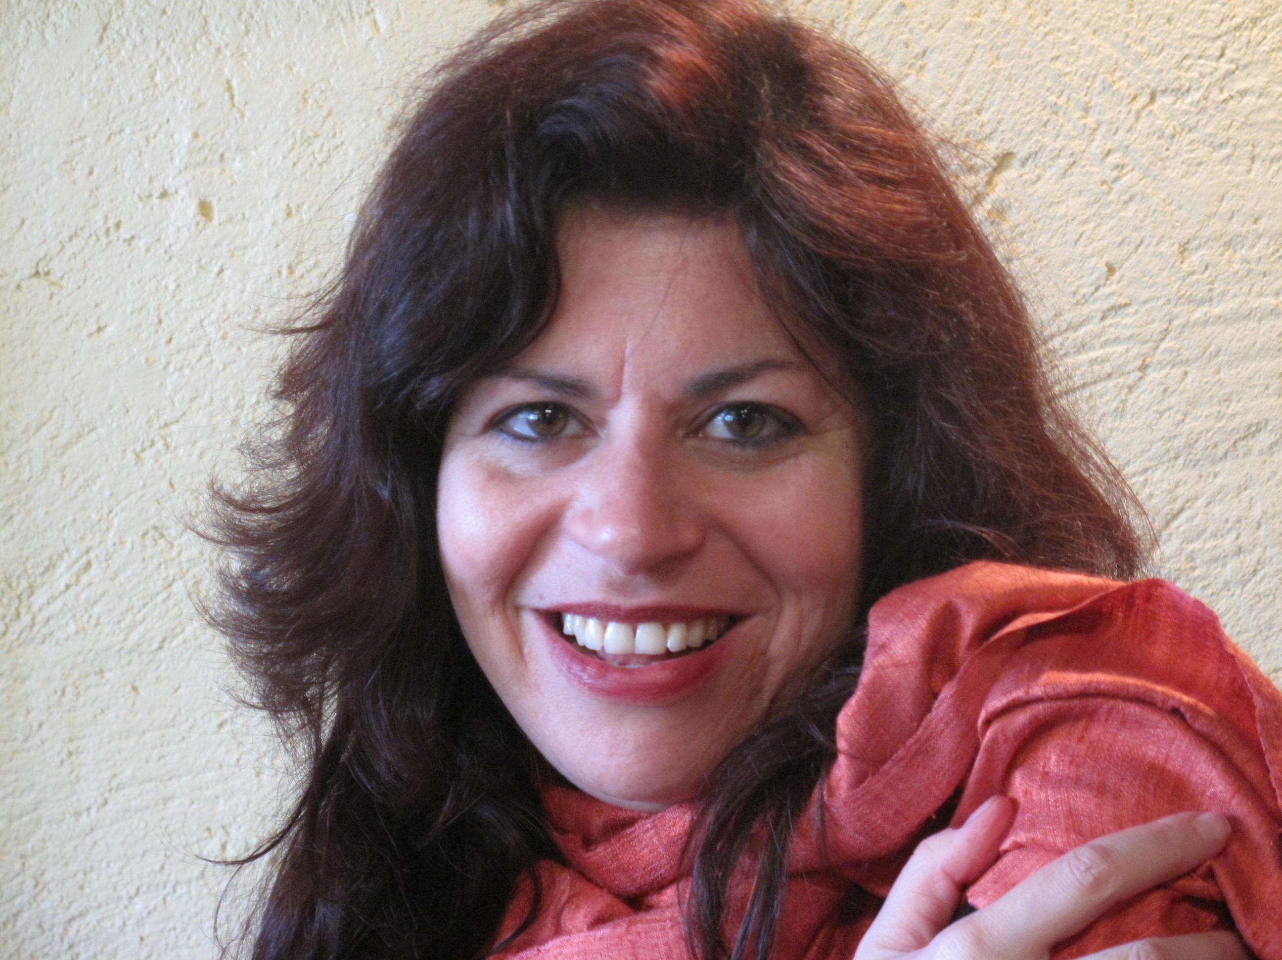
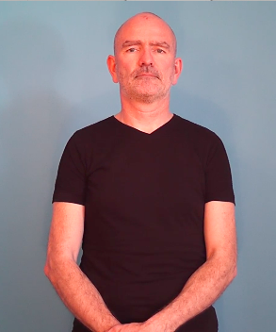
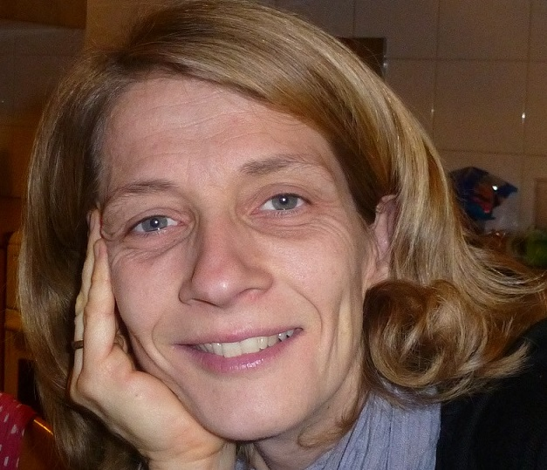
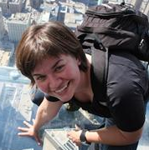
Thanks to
Hatice Aksen | Caroline Bogliotti | Marion Blondel | Stéphanie Caët | Clémentine Caron | Céline Fortuna | Saliha Héouaine
Frédéric Isel | Anaïs Lisette | Aliyah Morgenstern | Yves Prud’homme | Laetitia Puissant Schontz | Anna Safar
Academic Staff and French Sign Met partners
Scholar Staff
- Vanessa Andrieux, Marie-Paule Kerellhas, and all deaf teachers of Ramonville Saint Agne School
- CELEM school, Paris
- Audition Reeducation Center, Rouen
Students and Coders
and all deaf children
Notes:
In the future, we need to do some qualitative analysis, as measure the phoetic complexity of signs failed
Or measure the sign stream because late signers seems slowed their production
Further investigation could be run on SLI children in order to assess the screening power of SRT.
We have to determnie if SR abilities predictive of other language skills ? Maybe the next communication will answer this question .
We observed a significant difference in the repetition of Dominant Hand Classifier, suggesting that native children made less errors that late ones, and older that youngers,
In contrast, Frozen Sign and ND classifier are phonologically failed in the way for all populations.
We can conclude that native signers are better skilled in the production of dominant classifier becaue, as Classifier are closed class of signs, they produced more frequently this type of structures for different referents.
DH C = effet AOA et AC = faire graphique pour ces effet la
No effect for FS and non D H
= ce qui veut dire que sans dotue cela reglete des effets morphosyntaxiques

